Slide 1
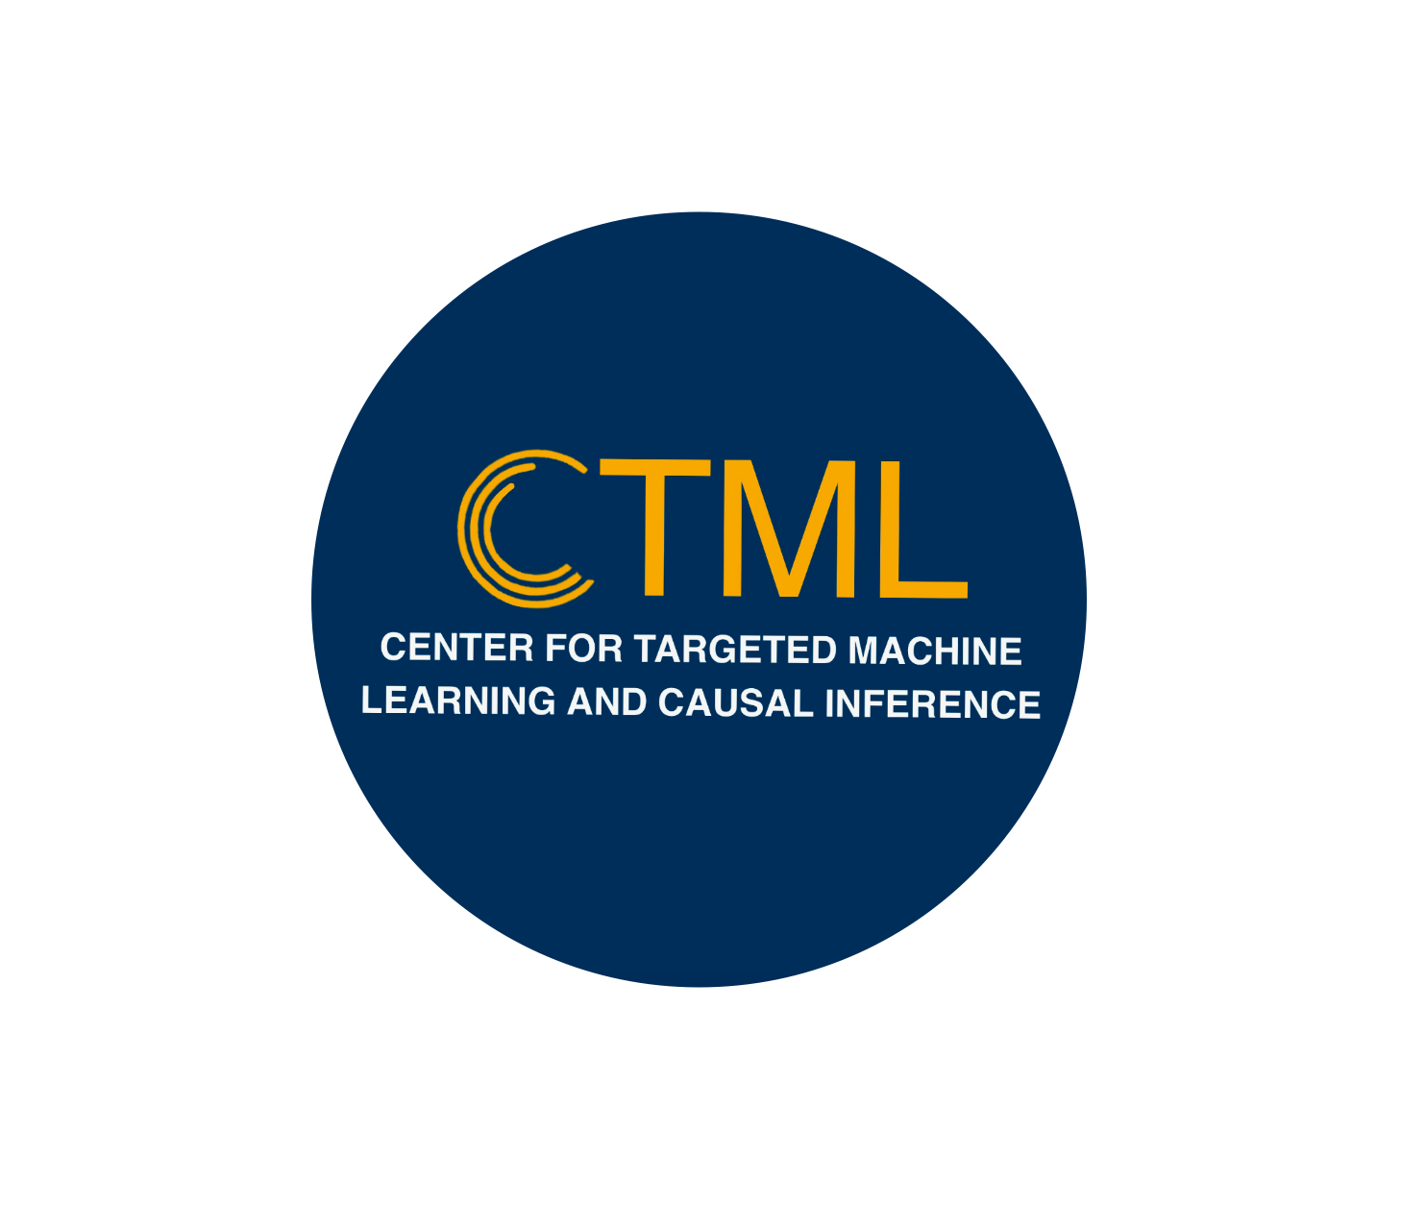
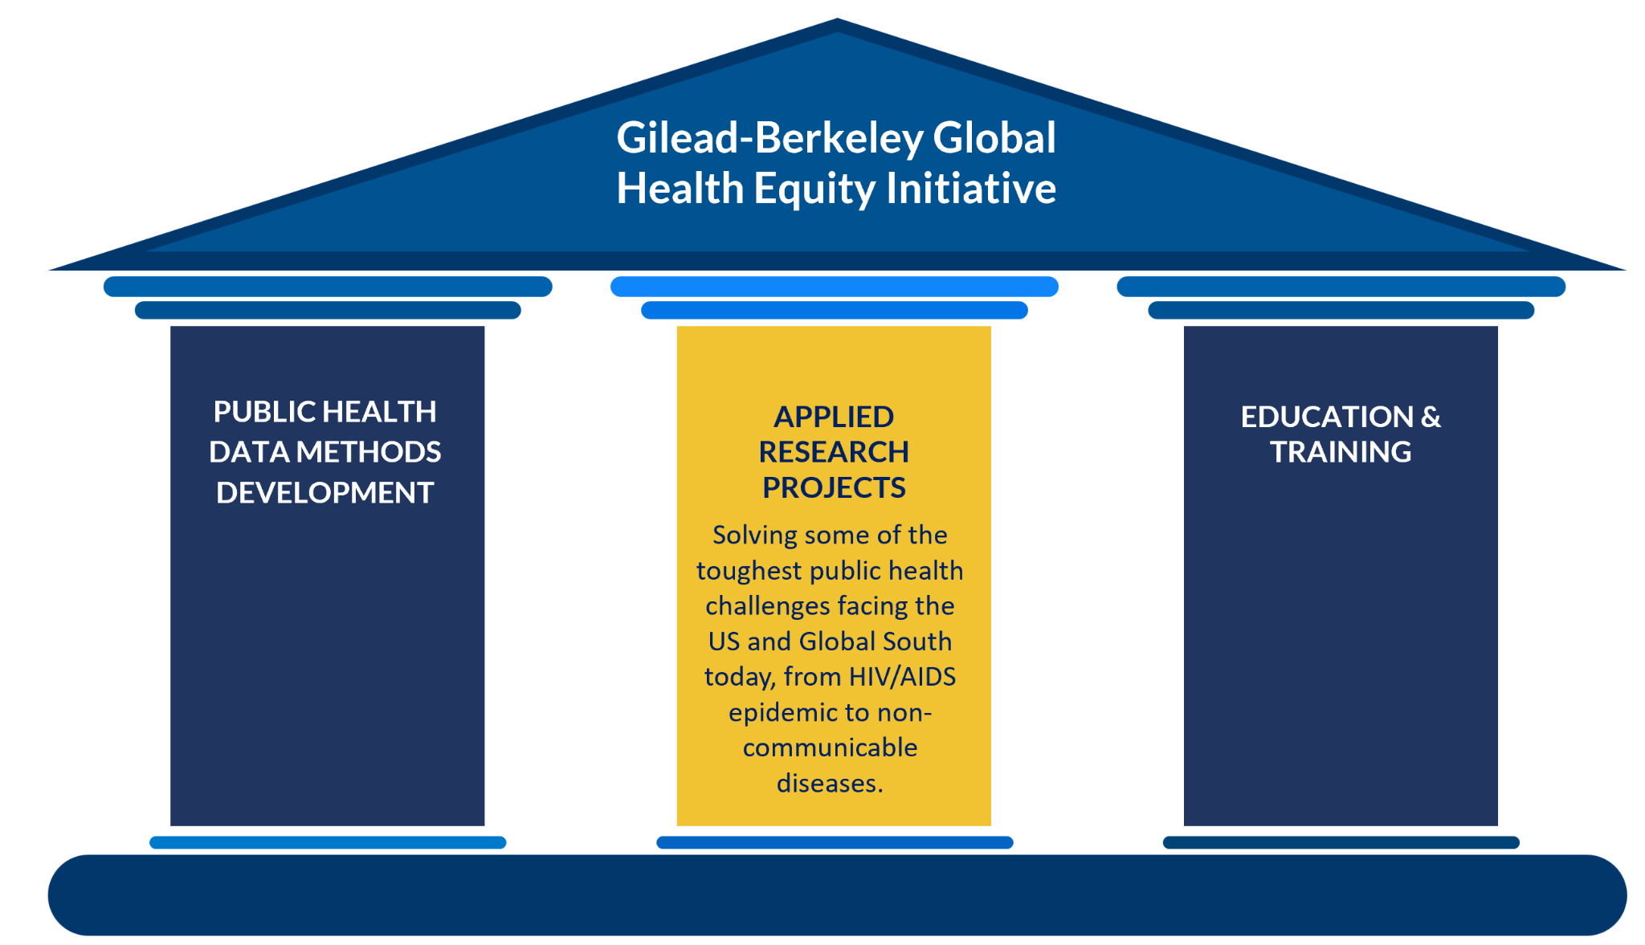
November 20, 2024
Gilead Methods Pillar introduction
Notes:
Maya

Slide 2
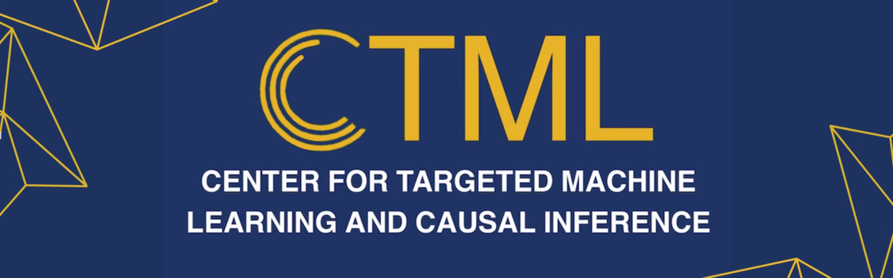
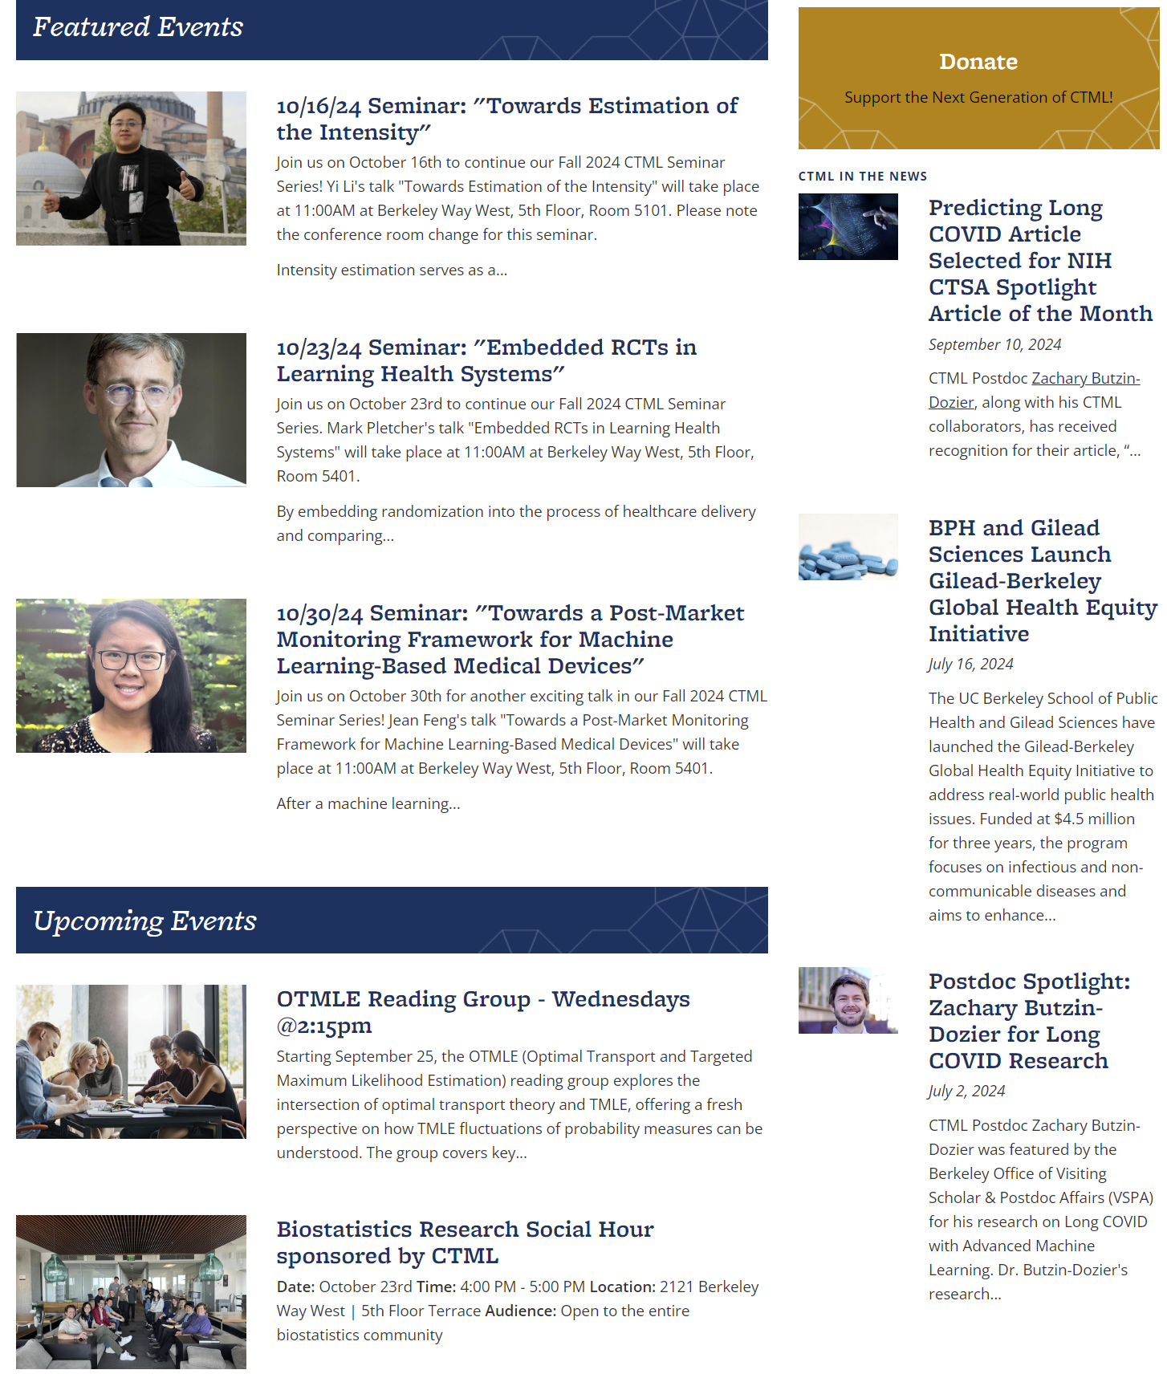
-An interdisciplinary research center advancing the state of the art in causal inference, machine learning, and precision health methods.
-Currently 33 faculty, staff, and students
-Focused on:
Methodological research
Software development
Outreach through workshops, seminars, and conferences
Collaborations with industry and regulatory statisticians to build consensus on best-practices
https://ctml.berkeley.edu/home
Notes:
Maya

Slide 3
The Causal Roadmap
Causal Model: Knowledge about observed conditions
Causal Estimand: Summary of ideal conditions
Identification: Causal Estimand ➔ Statistical Estimand
Statistical Estimation and Inference
Interpretation
Sensitivity analyses
Clear articulation of causal assumptions
Petersen & van der Laan, Epidemiology 2014; Dang et al 2023
Notes:
Sharp framing of causal question (“causal estimand”)
Transparent articulation of causal assumptions
> Improved data and design
Statistical estimation tailored to the causal question
Statistical estimators that meet performance benchmarks
Sensitivity analysis to allow for robust causal inference

Slide 4
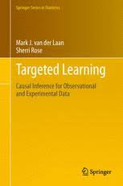
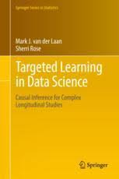
Targeted Learning
General statistical methodology (causal and non-causal)
State-of-the art machine learning
Targeted
Opportunity to reduce bias, reduce variance
Regain reliable inference
Efficient (minimal asymptotic variance)
If nuisance parameters estimated well
Often nice robustness properties
4

Slide 5
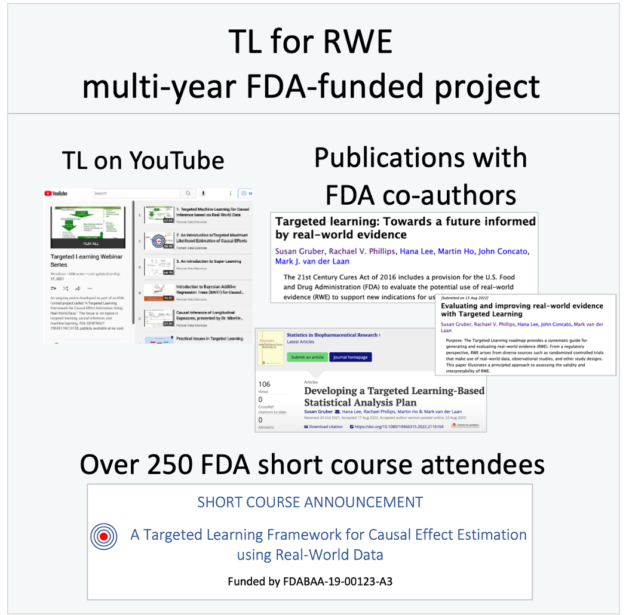
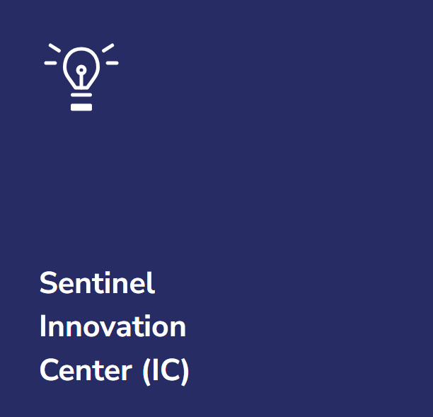
Select ongoing CTML projects
FDA collaborations to demonstrate Targeted Learning as part of real-world evidence generation: FDA Demonstration Project and Sentinal Innovation Center

Slide 6
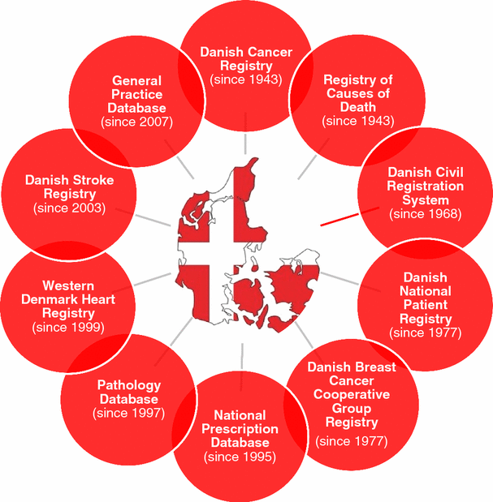
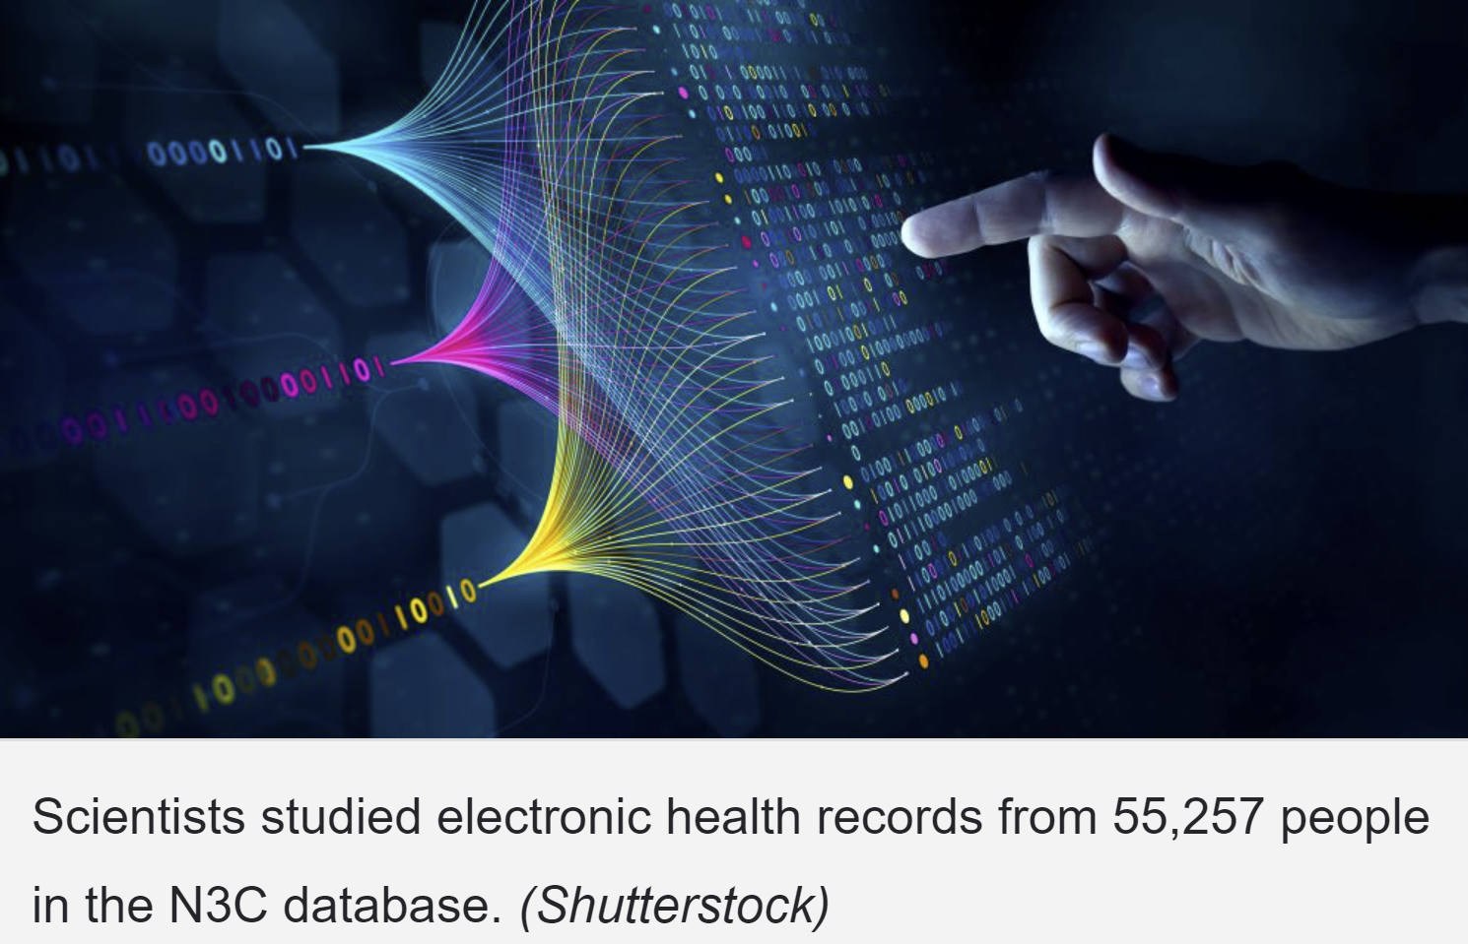
Select ongoing CTML projects
FDA collaborations to demonstrate Targeted Learning as part of real-world evidence generation: FDA Demonstration Project and Sentinal Innovation Center
Causal inference in large electronic health registries: Covid-19 in N3C and 2nd line diabetes treatments in the Danish National Registry

Slide 7
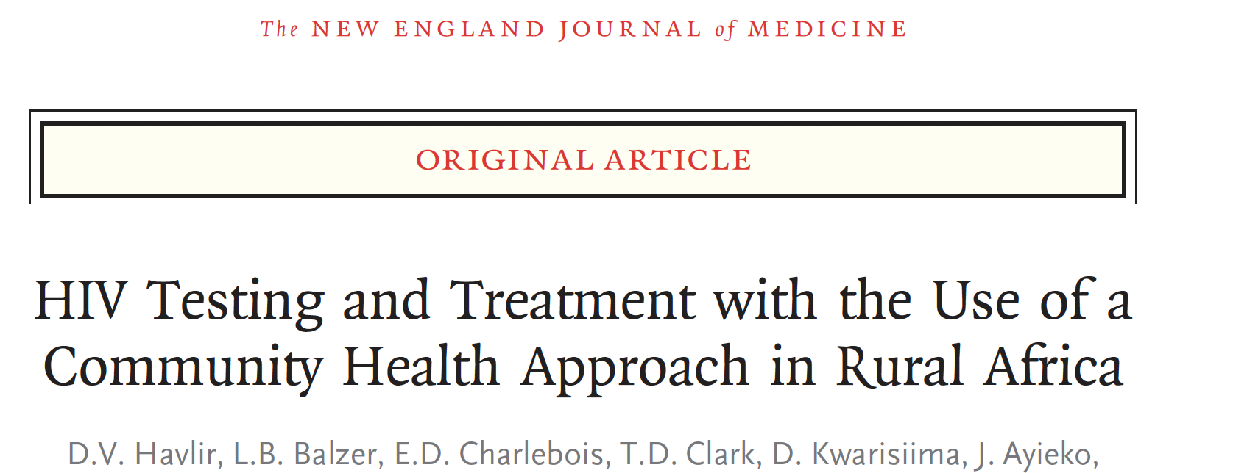

Select ongoing CTML projects
FDA collaborations to demonstrate Targeted Learning as part of real-world evidence generation: FDA Demonstration Project and Sentinal Innovation Center
Causal inference in large electronic health registries: Covid-19 in N3C and 2nd line diabetes treatments in the Danish National Registry
Improved Precision in RCTs: adaptive prespecification and TMLE in SEARCH HIV RCTs, TMLE methods for handling intercurrent events, treatment drop-ins, and continuous time

Slide 8
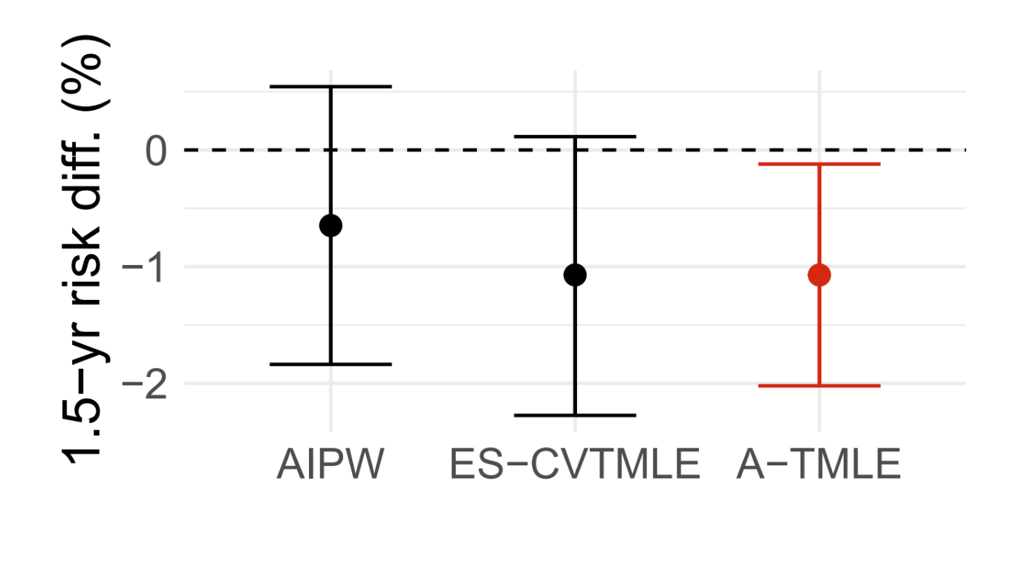
Select ongoing CTML projects
FDA collaborations to demonstrate Targeted Learning as part of real-world evidence generation: FDA Demonstration Project and Sentinal Innovation Center
Causal inference in large electronic health registries: Covid-19 in N3C and 2nd line diabetes treatments in the Danish National Registry
Improved Precision in RCTs: adaptive prespecification and TMLE in SEARCH HIV RCTs, TMLE methods for handling intercurrent events, treatment drop-ins, and continuous time
Integrating observational data into trial analyses without adding bias (Adaptive TMLE)

Slide 9
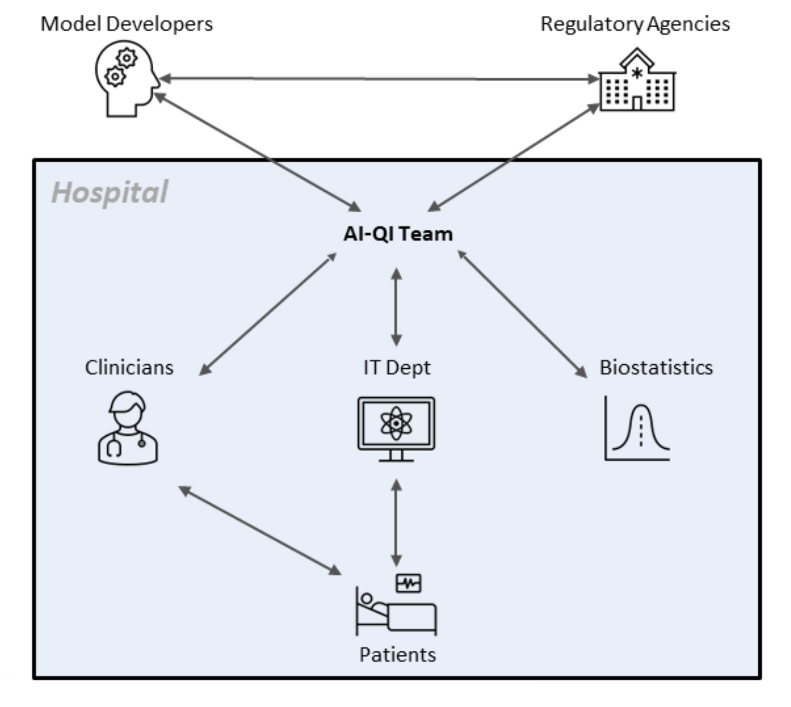
Select ongoing CTML projects
FDA collaborations to demonstrate Targeted Learning as part of real-world evidence generation: FDA Demonstration Project and Sentinal Innovation Center
Causal inference in large electronic health registries: Covid-19 in N3C and 2nd line diabetes treatments in the Danish National Registry
Improved Precision in RCTs: adaptive prespecification and TMLE in SEARCH HIV RCTs, TMLE methods for handling intercurrent events, treatment drop-ins, and continuous time
Integrating observational data into trial analyses without adding bias (Adaptive TMLE)
Quantifying the benefit of interventions in clinical settings: AI interventions and medical test effectiveness

Slide 10
Gilead methods pillar goals and approach
Advance and apply novel statistical methods for real-world evidence generation
Emphasizing targeted learning and causal inference approaches that support regulatory-grade analyses
Create reproducible analytic pipelines as demonstrations of improved workflows
Foster collaboration between Berkeley CTML and Gilead for knowledge transfer between researchers and students.
Disseminate advances through webinars, workshops, publications, and open-source software implementations.
Case studies to demonstrate methods advancements separate from Gilead research, but applicable to existing Gilead analytic challenges.
Implementing multi-tiered engagement model:
Yearly consortium meetings
Biweekly lab meetings for ongoing projects
Periodic seminars for knowledge exchange

Slide 11
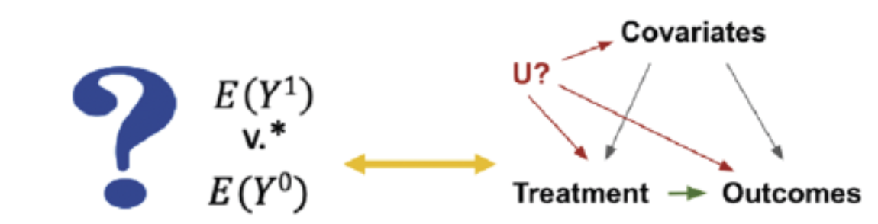
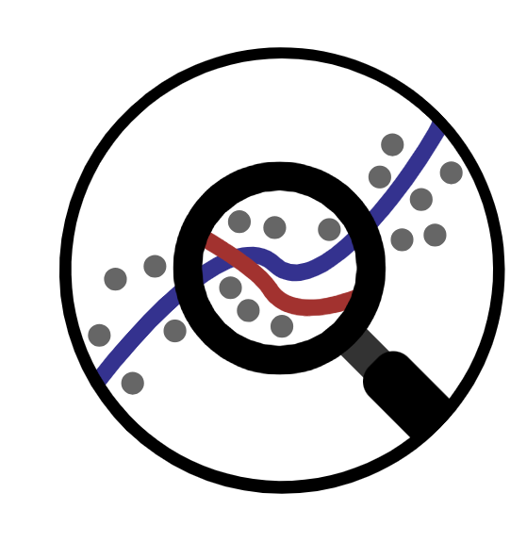
Gilead methods pillar progress and next steps
Kickoff planning meeting 10/26
FIORD 3.0 - November 7-8th
Data Science Symposium 2024 Keynote and panel
Planning spring 2025 half-day pillar event to showcase CTML projects and Gilead observational study challenges to broad audience (RWE, Biostats, CBEA, GHEOR, Advanced Analytics)
Spring GHED methods “lab meeting” series
Potential kickoff projects to be developed further in December:
Comparative safety analysis (possibly of osteoporosis treatments using claims data) to demonstrate targeted learning pipeline, including implementation of causal roadmap and use of TMLE
Simulation study evaluating relative performance, usability, and implementation considerations of TMLE compared to causalRisk, and CohortMethods packages to inform both TMLE software development
Using staging and clean room model, with extension to TMLE methods

